Slide 1
AVR Timer 0 Programming - CTC
Dr.Sreejith Rajan

Slide 2
Recap
Understood about Timer
Timer registers
Wrote a delay function using Timer 0 in normal mode without a prescalar
Done using prescalar as 64
We can use the available prescalar depending on our needs

Slide 3
TCNT0

Slide 4
AVR Timer

Slide 5
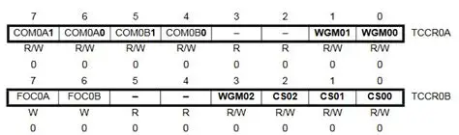
ATMEGA 328 TCCR 0

Slide 6
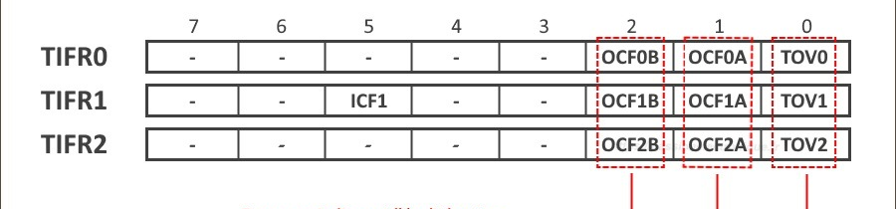
TIFR (Timer/Counter Interrupt Flag Register)
0
1
AtMega 328 TIFR

Slide 7
Timer 0 - CTC
CTC → Clear Timer on Compare.
What to compare - Value in TCNT0
Whom to Compare - A setpoint
Where is the setpoint - It can be saved in OCR0
0
1
OCR0 → Output Compare Register for Timer 0.
We have OCR0A and OCR0B.
Both are 8-bit registers
OCR0A – Used in CTC Mode and PWM. It can Reset the timer when TCNTO = OCR0A
OCR0B – Usually Used in PWM(Or an extra register for an interrupt event ). It cannot reset the timer.

Slide 8
What happens when TCNT0=OCR0A
OCF0A(Output Compare Flag for Timer 0) will be set in TIFR0 register.
So keep checking for it (That’s called polling)
0
1

Slide 9
Program Algorithm
Set CTC mode: WGM01=1, WGM00=0.
Load OCR0A with the calculated value.
Set prescalar (If wanted. choose closest available: 8 or 64).
Reset counter TCNT0=0.
Start timer.
Poll OCF0A flag in TIFR0.
When set, clear it and count 1 tick.
Repeat required ticks to build up the desired delay.
0
1

Slide 10
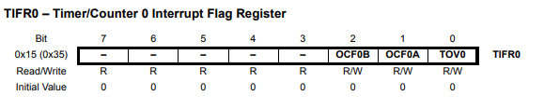
TIFR 0
0
1

Slide 11
Let’s start to be more professional- Modularity
Modularity
Breaking a big program into smaller, independent, reusable pieces (modules)
Key Idea
Header files (.h) = "What" (declarations, interfaces)
C files (.c) = "How" (definitions, implementations)
main.c = "When/Why" (application logic using the modules)
1

Slide 12
Modularity
Why Modularity is Important?
Readability
Reusability
Maintainability
Teamwork
Scalability
1

Slide 13
Lets make it modular
0
1

Slide 14
THANK YOU

